Slide 1
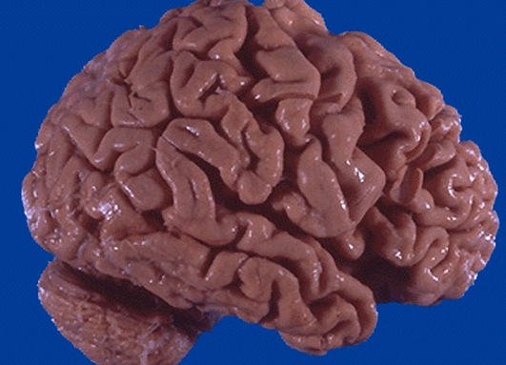
Cellular Adaptations
A patient presents to your office with Alzheimer's disease. What is the cellular adaptation?
Dysplasia
Metaplasia
Hyperplasia
Hypertrophy
atrophy

Slide 2
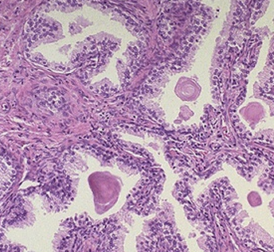
A patient presents with difficulty in urination. After digital exam you note the prostate is enlarged. (Histological samples from the lab shown to the right). This is an example of:
Hypertrophy
Hyperplasia
Dysplasia
Metaplasia
Neoplasia

Slide 3
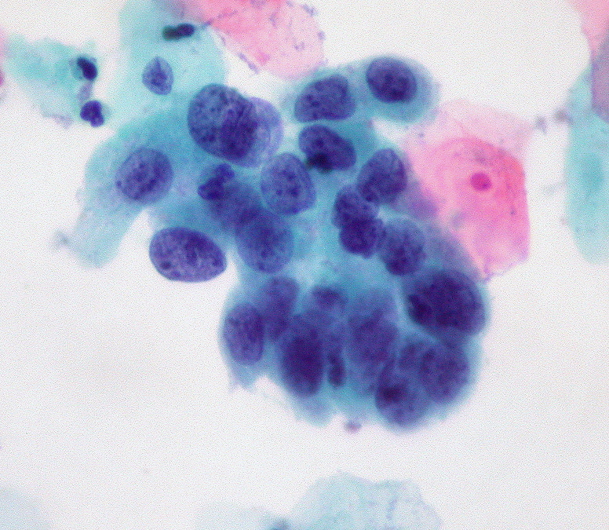
Cellular Adaptations
The following image is from a pap smear from a patient who tested positive for HPV infection. Name the cellular adaptation.
Hypertrophy
Atrophy
Dysplasia
Metaplasia
Hyperplasia

Slide 4
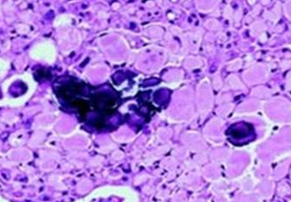
A patient sees you for a hardened nodule in his mouth. Radiographic tests show the nodule as semi opaque. Biopsy results are shown below. Blood analysis shows no hypercalcemia. You suspect an epithelial odontogenic tumor. What further remarks can be made about this image?
a) The tumor shows central metastatic calcification b) The central necrosis has lead to aggressive immune infiltration c) The tumor shows a low N/C ratio, and is highly anaplastic d) the biopsy shows central dystrophic calcification
e) Further diagnostic testing is needed to elucidate pathology

Slide 5
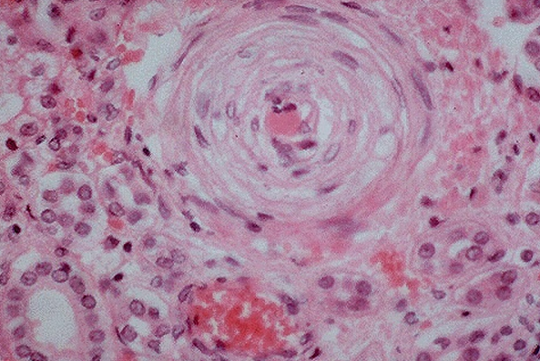
A patient presents with malignant hypertension. On histological examination (shown) there is marked occlusion of the vessel. This is due to:
Fibrinoid necrosis
Thrombus
Atherosclerosis
Hyperplasia
Collagen deposit

Slide 6
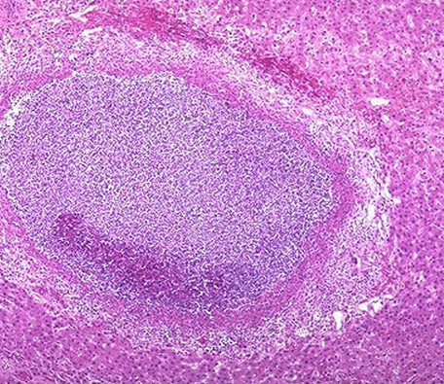
A 58 year old male presents to your office with right upper quadrant pain. On physical examination you note edema and hepatomegaly. Biopsy of the liver is shown. Which term best describes this image:
Caseating necrosis
Caseating granuloma
Gangrenous necrosis
Granulation tissue
Liquefactive necrosis
Notes:
Interruption of blood supply. Total necrosis of the center

Slide 7
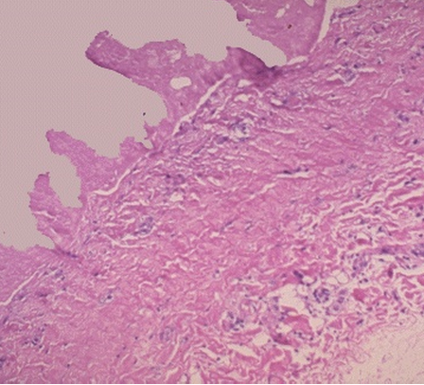
A 45 year old male presents with chest pain. The histological sample of the pericardium is shown below. Which term best describes the image:
Caseating granuloma
Liquifactive necrosis
Myocardial infarction
Fibrinoid necrosis
Fibrinous exudate

Slide 8
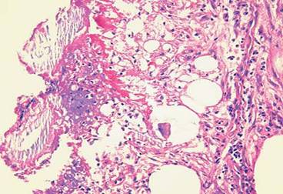
The following image was taken from a patient who showed signs of acute pancreatitis. This represents:
Apoptosis of acini
Neoplastic change
Saponification
Ossification
Dysplasia

Slide 9
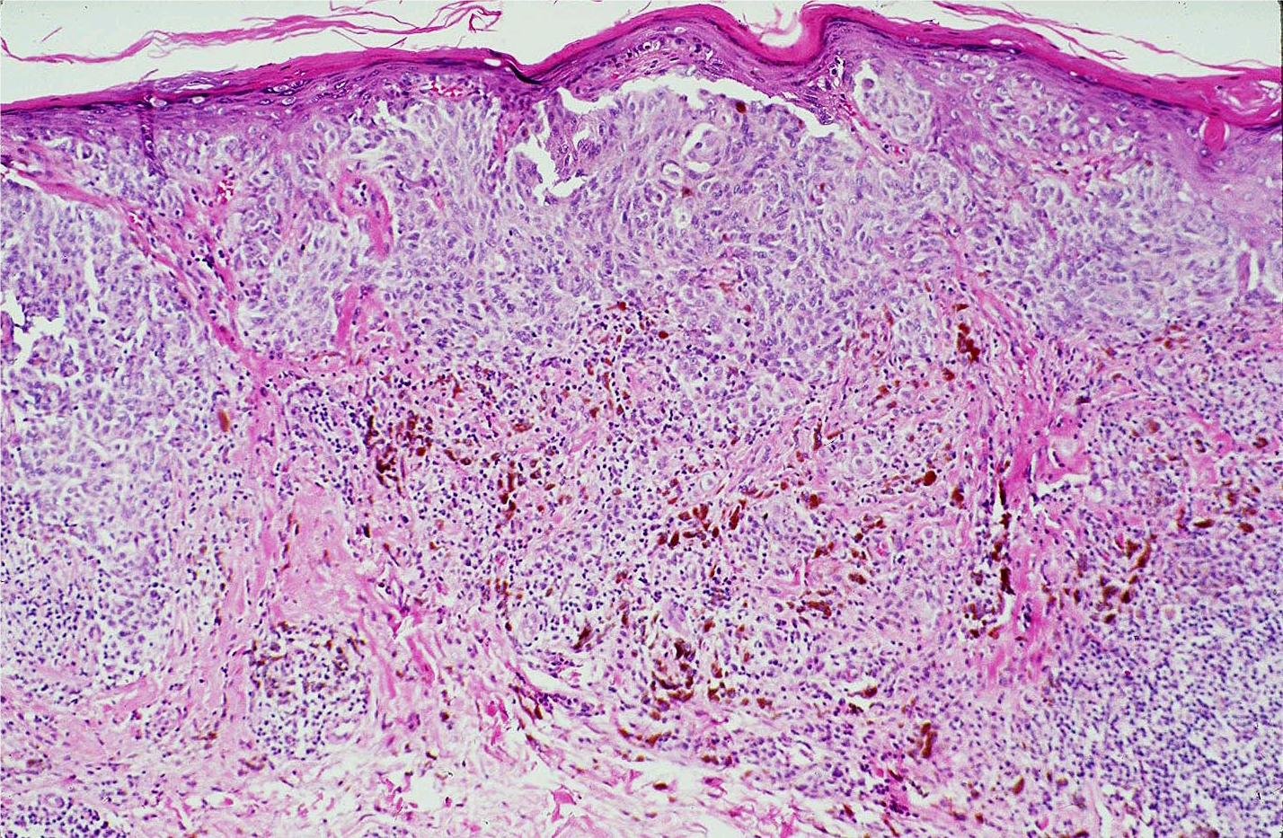
A 45 year old woman of Polynesian decent comes to your office with complaint of a growth on her skin. She has a history of smoking but has stated she quit 5 years prior to the visit. In the attached image, which of the following substances has accumulated, which is diagnostic for the pathology.
Keratin
Vimentin
Melanin
Neurofibrilin
GFAP

Slide 10
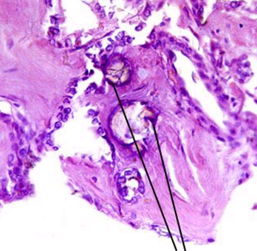
The image shows metastatic calcification
True / false

Slide 11
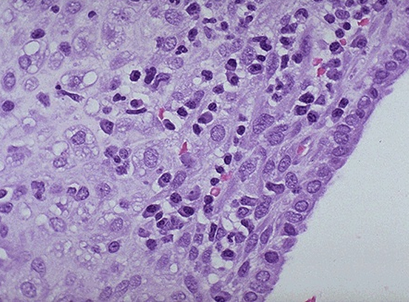
A 53 year old woman presents with dull aching pain in her pelvic region for the last few months. Patient has a family history of cervical cancer. Lab cultures is positive for Treponema Pallidium. Biopsy of the tissue reveals:
Dysplasia of endometrium
Acute inflammation
Chronic inflammation
Dysplasia of cervix
Granulation tissue

